Slide 1
d4k Microservice Architecture
Small steps, big effect
Version 2
24th July 2024

Slide 2
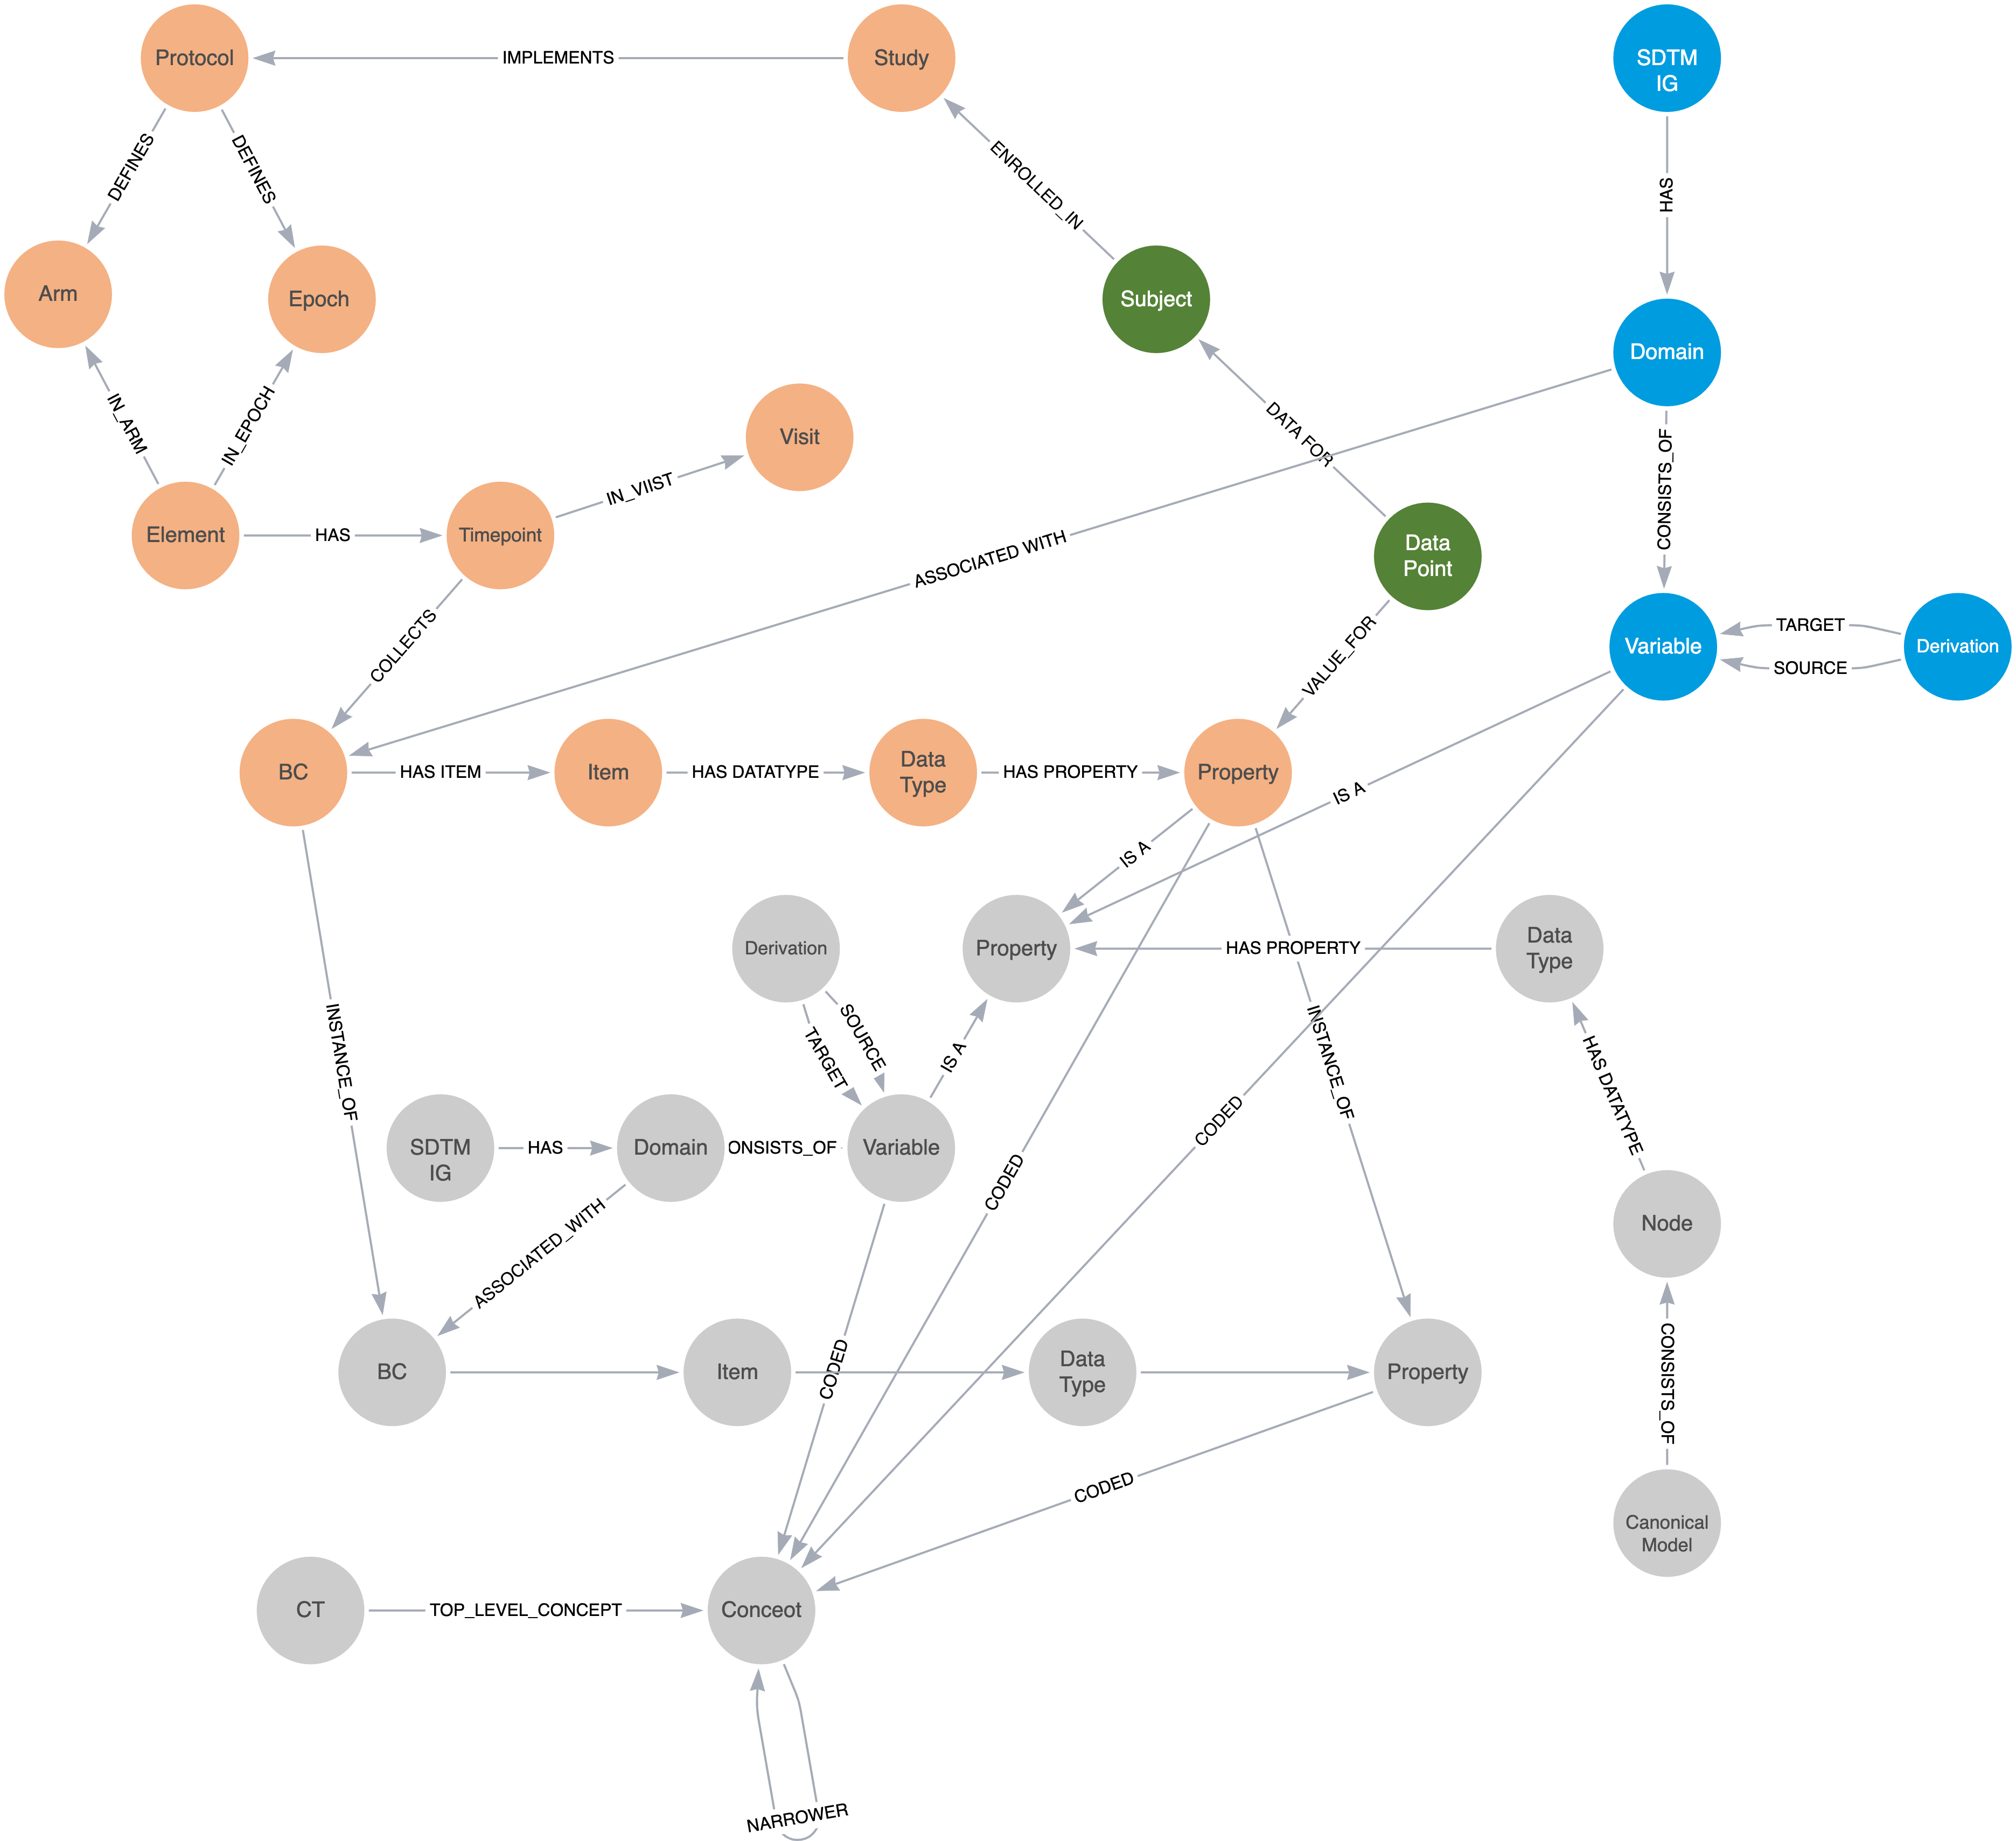

From Silos To Knowledge
2
Study Design & Configuration
Solid Foundation
A well defined set of definitions sourced from the CDISC library and elsewhere combined with a Biomedical Concept (BC) library. BCs are a unit of knowledge, pre-defined and bound to terminology that are ready to be linked into studies. The BCs provides reusable components that bring data consistency across study builds and data collection and thus subsequent processing. The BCs protect our study data against future capture technology change.
Study Build
Combining the power of a study design model, e.g. the TransCelerate Digital Data Flow (DDF) Study Design Model, and BCs allows for complete and well structured machine-readable study designs to be constructed. The combination provides for a precise study data contract that benefits the data collection process. It also allows for study artefacts such as define.xml and study annotated CRFs to be produced in an automated manner prior to a single data point being captured.
1
CDISC Library +
And We Gain …
Other desired outputs such as OMOP can be produced (queried) from the same graph. We achieve a repository of searchable “studies”, both the metadata and the data, all linked.
Old studies can be imported and brought back to life to prevent data decay and the model will allow for translations between SDTM versions. Multiple studies can be held together and thus searched and queried. We achieve our goal of better data: better data quality (from the BCs being more precise) and better data utility (from the linking into a single graph and access to the study design).
3
2
5
Data
Data Utility
Import Data
Data can be imported from a variety of sources in a range of formats including tabular (e.g. lab) formats and from other sources such as HL7 FHIR (RWE). The use of a ”translation” model (the canonical model) allows for a variety of input sources to be accommodated.
Automate SDTM
A precise and well structured study design linked to the subject data via BCs provides for a complete study graph from which SDTM can be queried and the datasets produced. Edge cases and supplemental qualifiers need consideration but the BC design allows for such flexibility.
4
1
SDTM Export

Slide 3

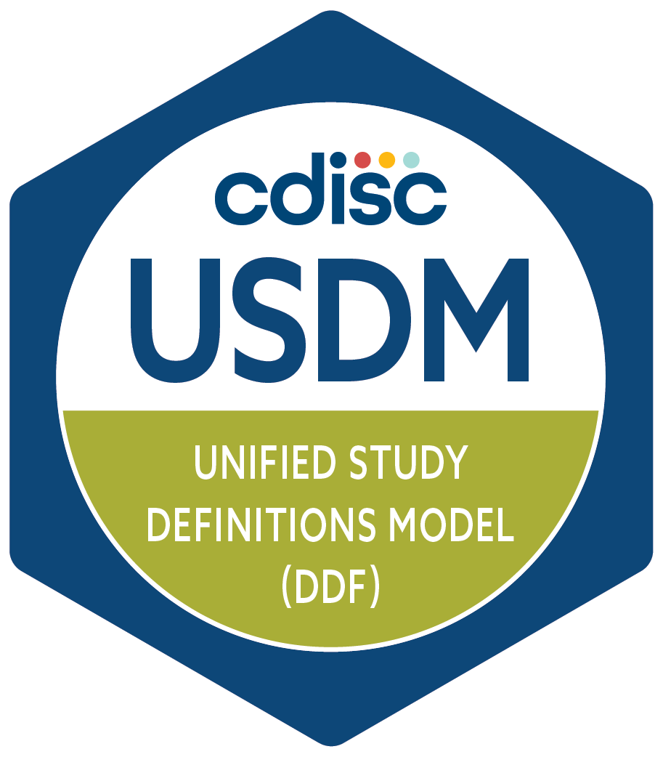
High Level Architecture
Microservices Architecture
A series of cooperating microservices each task with a focused area of functionality. A set of services can be deployed to meet a given business need.
See the paper: Towards Collaboration, Dave Iberson-Hurst, 2021
JSON
USDM JSON Store
Study
Definition Workbench
Study
Definition & Data
Neo4j
Neo4j Graph DB
JSON
Neo4j
USDM Foundation
User Interface
DL
Data Loader
CT
BCs
Forms
SDTM
Microservice
Neo4j
Neo4j
DL
Neo4j
Neo4j
DL
DL
CDISC API

Slide 4
Key Areas
Study
The study, its design and its data, all linked providing the source of knowledge
Microservices Architecture
A series of cooperating microservices each task with a focused area of functionality. A set of services can be deployed to meet a given business need.
See the paper: Towards Collaboration, Dave Iberson-Hurst, 2021
JSON
USDM JSON Store
Study
Definition Workbench
Study
Definition & Data
Neo4j
Neo4j Graph DB
JSON
Neo4j
USDM Foundation
Tools
Key tools to support adoption
User Interface
DL
Data Loader
CT
BCs
Forms
SDTM
Microservice
Neo4j
Neo4j
DL
Neo4j
Neo4j
DL
DL
Solid Foundation (Definitions)
Definition services that provide key definitions and the management thereof. Equivalent to what is seen currently as an “MDR”
CDISC API

Slide 5
Demonstrated
Microservices Architecture
A series of cooperating microservices each task with a focused area of functionality. A set of services can be deployed to meet a given business need.
See the paper: Towards Collaboration, Dave Iberson-Hurst, 2021
JSON
USDM JSON Store
CDISC 2024 EU Interchange Berlin
PHUSE 2024 EU Connect, Strasbourg
This configuration was that demonstrated at the EU interchange. An enhanced version will be used as part of a workshop in Strasbourg in November 2024
Study
Definition Workbench
Study
Definition & Data
Neo4j
Neo4j Graph DB
JSON
Neo4j
USDM Foundation
User Interface
DL
Data Loader
CT
BCs
Forms
SDTM
Microservice
Neo4j
Neo4j
DL
Neo4j
Neo4j
DL
DL
CDISC API

Slide 6
Vision
Advanced Use Cases
Option to replace JSON file store with Neo4j Graph DB for more advanced use cases / tools
Envisaged Functions
Import M11 DOCX Protocols (in progress)
Import USDM Excel (in progress)
Import USDM JSON
Import existing protocol (maybe with ML/AI assistance)
Export USDM JSON
Export M11 FHIR
Dashboards
Compare JSON
Simple Editing
CORE validation
… and more
Study
Definition Workbench
Study
Definition & Data
JSON
Neo4j
Merge Existing Tools
USDM Test Data Tool
M11 Mapping Tool
Protocol Conversion Tool
CT
BCs
Forms
SDTM
Neo4j
Neo4j
DL
Neo4j
Neo4j
DL
DL
CDISC API

